Slide 1

Calories Burnt Prediction Using AI-Based Machine Learning System
An AI-driven approach to predict calories burnt during workout sessions Applying Machine Learning for personalized fitness insights
KIC-HNDCSAI-252F-031
KIC-HNDCSAI-252F-039
KIC-HNDCSAI-252F-012
KIC-HNDCSAI-252F-032
KIC-HNDCSAI-252F-003

Slide 2

Introduction
Accurate calorie burn estimation is essential for:
Fitness tracking
Weight management
Personalized workout planning
However, calorie expenditure varies significantly across individuals due to:
Biological differences
Workout intensity and duration
Recent advancements in Artificial Intelligence (AI) and Machine Learning (ML) enable data-driven, personalized predictions instead of fixed formulas

Slide 3

Problem Statement
Traditional calorie calculation methods:
Use static equations
Ignore individual physiological differences
Provide generalized and often inaccurate results
Problems:
Inaccurate predictions
No personalization
Limited insights
Need: An intelligent AI-based system that can learn from real workout data and predict calories burnt accurately

Slide 4

Project Objectives
Primary Objective: Develop an AI system to predict calories burned
Specific Objectives:
Analyze real-world workout and biological data
Train and evaluate multiple ML models
Identify the best-performing AI model
Develop web-based system
Provide personalized fitness insights

Slide 5

Proposed AI Solution
The proposed system uses Artificial Intelligence and Machine Learning to predict calorie expenditure
AI-based approach:
Learns patterns from real data
Captures non-linear relationships between features
System Capabilities:
Accurate calorie prediction
Personalized insights
Real-time interaction via web app

Slide 6

System Architecture (Project Pipeline)
1. Data Collection
2. Data Preprocessing
3. Exploratory Data Analysis (EDA)
4. AI Model Training
5. Model Evaluation
6.Best Model Selection
7.Calorie Burn Prediction Output (Web App)

Slide 7

Dataset Description
Multiple datasets used:
Gym Members Dataset (Primary)
Fitness Metrics Dataset (Environmental)
Exercise Dataset (Recommendations)
Mendeley AI Coaching Dataset (Recommendation)
Open Weather API
Includes:
Physiological data
Workout data
Environmental data

Slide 8

Features Used
Input Features:
Age, Gender
Height, Weight, BMI
Heart Rate
Workout Duration
Exercise Type
Exercise Intensity
Weather Conditions
Target:
Calories Burned

Slide 9

Data Preprocessing
Encoding categorical data
Feature scaling (Standard Scaler)
Removing redundant features
Purpose:
Improve model performance
Ensure balanced feature contribution

Slide 10

Exploratory Data Analysis (EDA)
EDA performed to identify patterns and relationships
Key Insigts Planning fo Future:
Strong positive relationship between variables and target (calories burnt)
Heart rate significantly influences calorie burn
Gender based differences observed
EDA helps AI models learn meaningful data patterns

Slide 11
AI / Machine Learning Models Used
Multiple models will be trained and compared
Linear Regression
Simple baseline model
Random Forest Regressor
Ensemble of decision trees
XGBoost Regressor
Gradient boosting technique with high accuracy
Neural Networks
Artificial Neural Network

Slide 12

Tools & Technologies
Tools & Technologies:
Programming Language: Python
Development Environment: Jupyter Notebook / Google Collab
Libraries:
NumPy, Pandas (Data handling)
Matplotlib, Seaborn (Visualization)
Scikit-learn (ML models + preprocessing)
XG Boost (Boosting model)
Preprocessing Tools:
Standard Scaler (Normalization)
Label Encoding (Categorical conversion)
Evaluation Metric:
Mean Absolute Error (MAE)
Root Mean Squared Error (RMSE)
R-Squared Score
Cross-validation used to ensure reliability

Slide 13
Tentative Timeline
Week 1: Dataset collection, merging & initial inspection
Week 2: Data cleaning, preprocessing & feature engineering
Week 3: Exploratory Data Analysis (EDA) + correlation analysis
Week 4: Train multiple ML models (Linear + Tree-based models)
Week 5: Model evaluation (MAE) + best model selection (XGBoost)
Week 6: Final testing, results documentation & final presentation preparation

Slide 14
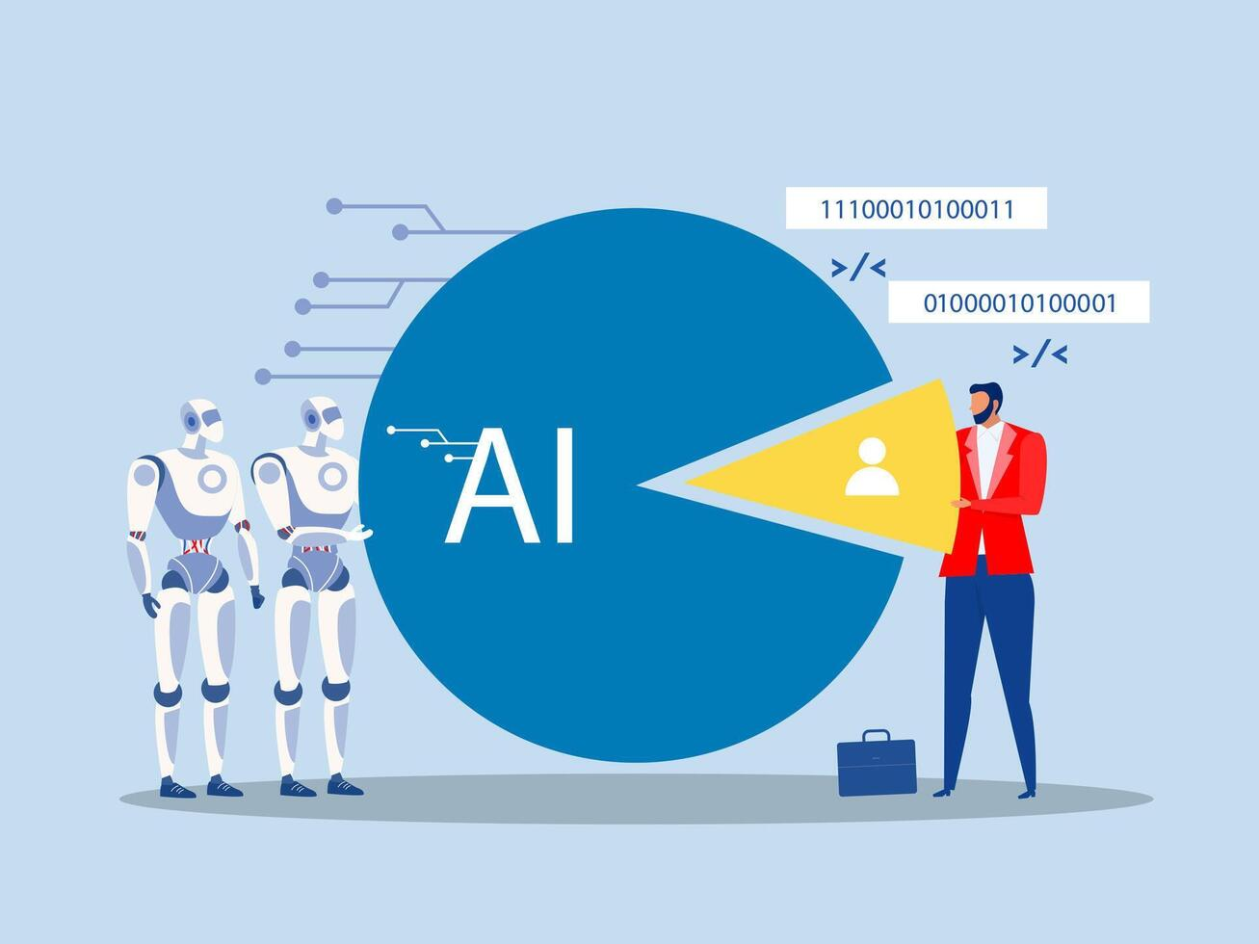
Expected Outcomes
This AI based system is expected to deliver the following outcomes:
Accurate calorie burnt prediction based on real workout data
Improved prediction compared to traditional formula based methods
Identification of the best-performing ML model as ANN
User friendly prediction output that supports fitness decision making
Web based system interaction

Slide 15

AI Smart Fitness Coach
System goes beyond prediction
Provides:
Personalized workout suggestions
Exercise recommendations
Fitness goal guidance
Based on user profile + AI dataset

Slide 16

Environmental Context Integration
Uses real-time weather data
Factors:
Temperature
Humidity
Weather condition
Makes prediction more realistic

Slide 17
Web Application
User inputs:
Age, weight, workout details
Output:
Calories burned
Fitness insights
Features:
Simple UI
Real-time prediction
Interactive system

Slide 18
System Architecture
Data Processing Layer
Machine Learning Model
Backend System
Web Interface
External API (Weather Data)

Slide 19

Risks & Mitigation
Overfitting → Cross-validation
Data leakage → Proper data split
Deployment issues → Consistent pipeline
Dataset limitations → Use multiple datasets

Slide 20

Security, Privacy & Ethics
No permanent data storage
User data used temporarily
Not medical advice
Transparency in limitations

Slide 21

Limitations
Prediction accuracy depends on dataset quality
Dataset may not cover all types of physical activities
No real-time sensor or wearable device integration
Limited representation of individual metabolic differences
Environmental factors may not always reflect real conditions
Therefore:
Predictions are approximate estimates, not medical-grade values

Slide 22

Conclusion
AI based approach improves calorie prediction accuracy
Machine learning captures complex relationships in fitness data
System provides personalized fitness insights and recommendations
Web-based implementation enables real-time user interaction
Overall:
A smart, data-driven solution for improving fitness tracking and decision-making

Slide 23

Any Questions?

